Slide 1
TABLEAU – DATA VISUALIZATION
Presented By,
S . Aishwarya ,
Asst. Professor ,
Dept. of AI&DS ,
SMVEC.

Slide 2

What is Data Visualization
Visual representation of data
It involves the use of charts, graphs, maps, and other visual elements to represent data patterns, trends, and relationships.
Complex data more understandable, insightful, and accessible to a wide audience.
Business, science, finance, healthcare, and journalism.

Slide 3

Why we need Data Visualization in Machine Learning?
Model evaluation
Insights and explanations
Communication and storytelling.

Slide 4
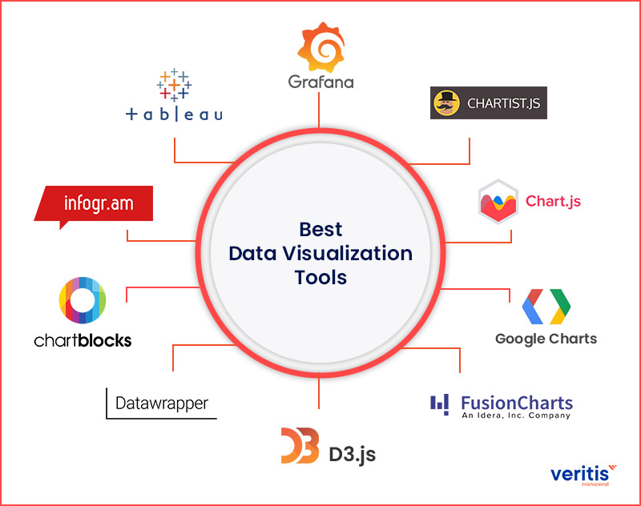
Data Visualization Tools

Slide 5

Introduction to Tableau
Tableau is a powerful data visualization tool that allows users to connect, visualize and share data in a way that can help them make better decisions.
Businesses, organizations, and individuals around the world.

Slide 6

The History of Tableau Software
Tableau Software was founded in 2003 by Chris Stolte, Christian Chabot, and Pat Hanrahan.
Understand a data to use of business intelligence
Used in 86000 customers
More powerful and easy

Slide 7
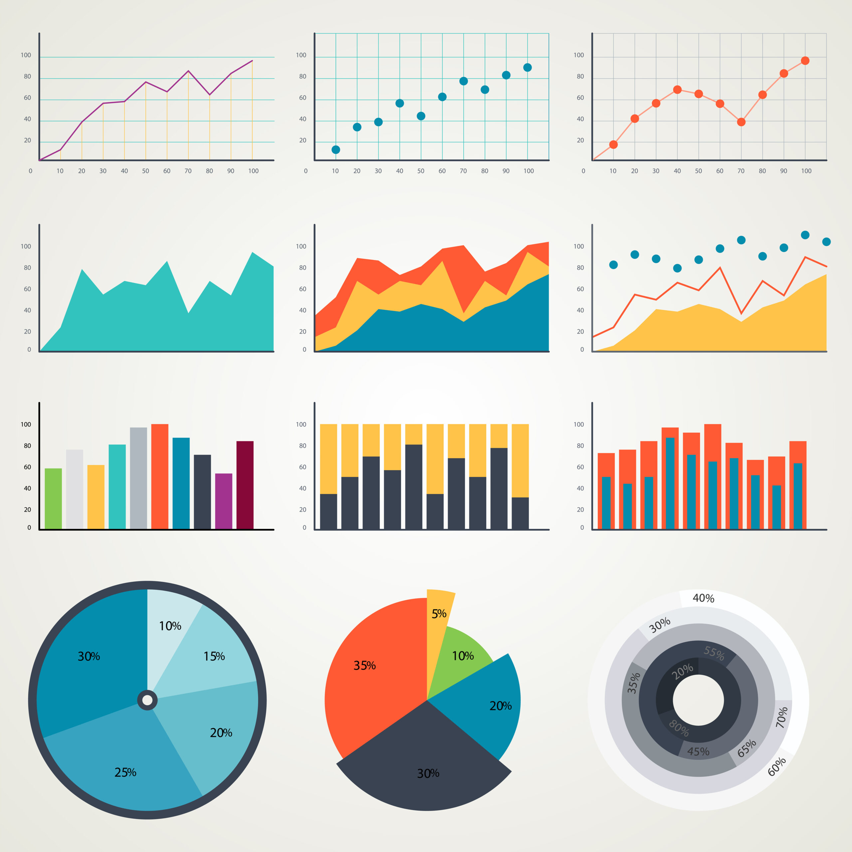
Different Types of Plots

Slide 8

Getting Started with Tableau
Connect various data sources
Once connected, users can drag and drop data onto the canvas to create visualizations.
Use a required plot to visualize

Slide 9

HANDS – ON

